Slide 1
SARAB YOUSSEF KAMANEH AKHAVAN
D
C AMBLE
LT2216 Dialogue Systems-Project

Slide 2
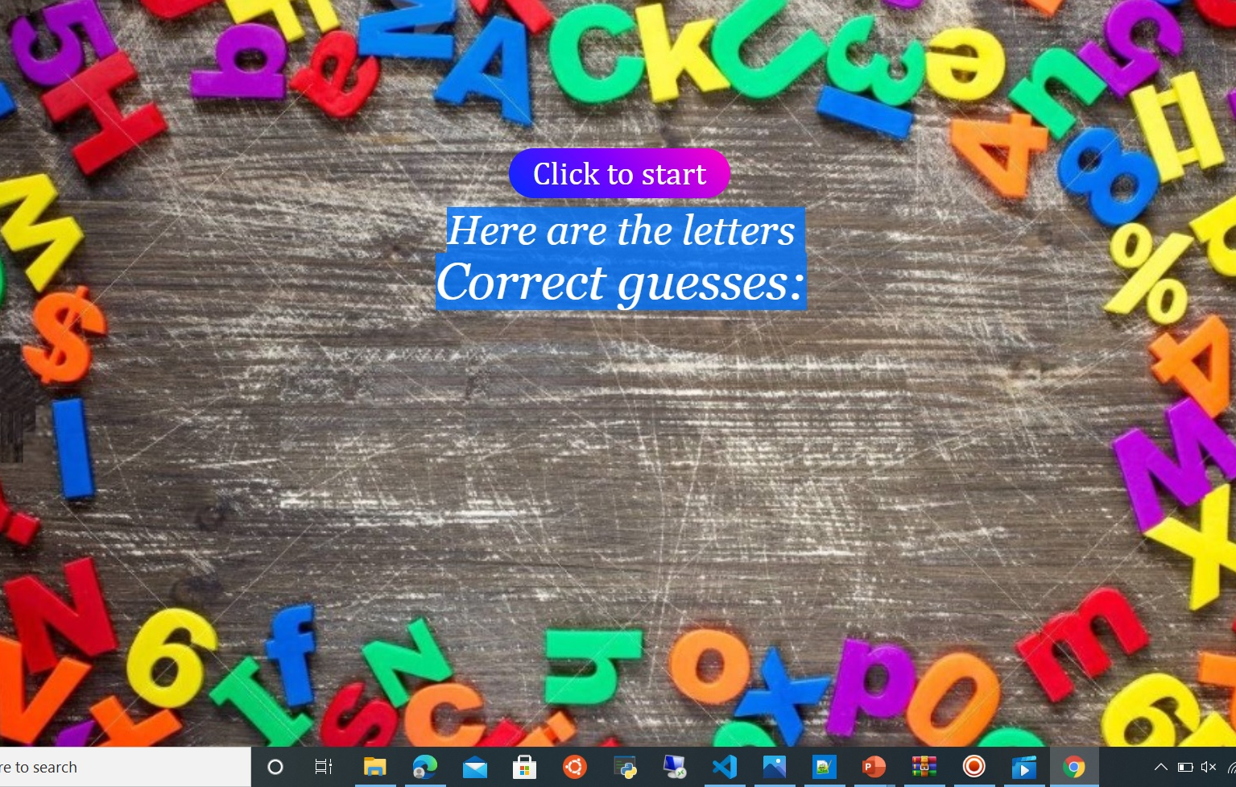
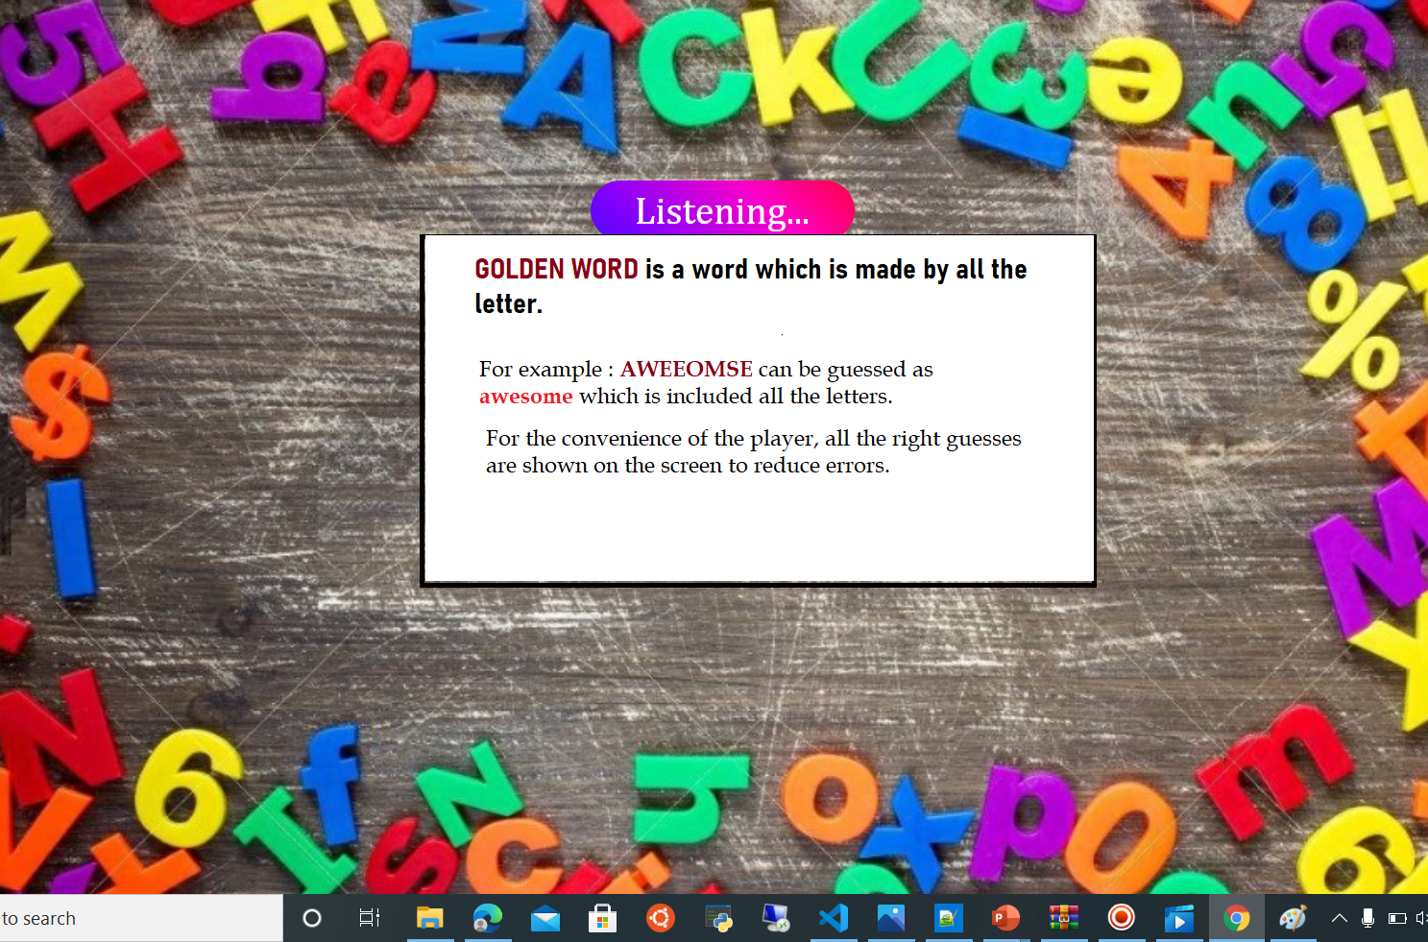
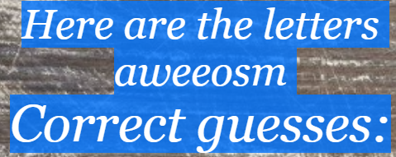
What does the game?
DESCRIPTION :
Start the game by clicking “Click to start”
Scrambled letters are shown up and the player should form 5 meaningful words from these letters to win and move to the next level.
Hints
Use jump: no more than 4 times
Waiting time for 10 seconds
Find the golden word
In case of winning or losing what to do next: play, eat or study
LT2216 Dialogue Systems-Project

Slide 3




TOOLS AND PLATFORMS
React
HTML
CSS
Xstate
LT2216 Dialogue Systems-Project

Slide 4
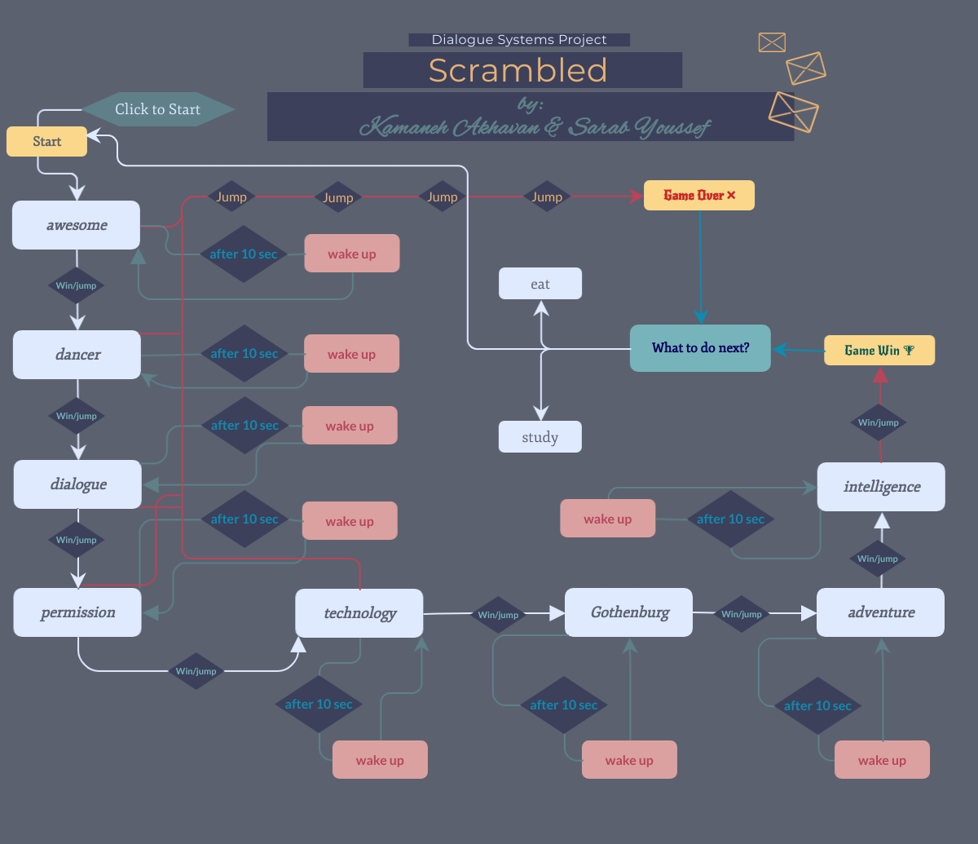
Flow Chart
LT2216 Dialogue Systems-Project

Slide 5
CHALENGES
Not accepting a previously guessed word
Rasa problems
Add the last guessed word to the list of words
Display the word not only on the console but in the browser after adding two new states
Moving to the next level after abstracting the states
Voice recognition not working well and does not recognize all the words said by the user
LT2216 Dialogue Systems-Project

Slide 6
RELATION TO THE COURSE CONTENTS
Practical(labs)
Lab I: training Rasa
Lab II: TypeScript, xstate and invocation
Lab IV: history, timout and count
intents
LT2216 Dialogue Systems-Project

Slide 7


FUTURE WORK
Better graphics
Make it faster
Use a Dictionary
Improve the code
Improve voice recognition
Make it more attractive especially for the kids
Take the orders or the answers faster
Use a dictionary to pick long words as the golden words and use the letter of these words to form other meaningful words
Take more than one word at once
Determine the length of the words and the how many words of each length
Voice recognition sometimes doesn’t hear the correct words and mistake it for others
LT2216 Dialogue Systems-Project

